Slide 1
Web Driver test with Xunit-TestNG
By Sravani

Slide 2
Introduction to XUnit and JUnit
Java provides a framework called JUnit to perform the unit testing of our Java code. In the development of test-driven development, JUnit is very important.
The JUnit is one of the frameworks available in the unit testing frameworks.
The x Unit is the unit testing framework family, and JUnit is the part of the x Unit.
All X Unit frameworks share the following basic component architecture, with some varied implementation details

Slide 3
JUnit Annotations
The Junit 4.x framework is annotation based, so let's see the annotations that can be used while writing the test cases.
@Test annotation specifies that method is the test method.
@Test(timeout=1000) annotation specifies that method will be failed if it takes longer than 1000 milliseconds (1 second).
@BeforeClass annotation specifies that method will be invoked only once, before starting all the tests.
@Before annotation specifies that method will be invoked before each test.
@After annotation specifies that method will be invoked after each test.
@AfterClass annotation specifies that method will be invoked only once, after finishing all the tests.

Slide 4
Assertions/Verifications with JUnit or TestNG
TestNG Assert methods will be the same as the Junit assertion methods that are discussed above. The major difference between Junit and TestNG assertion methods come in the way of handling assertions.
TestNG provides more advanced assertion handling techniques such as dependent classes, Group tests, Parameterized tests, etc.
JUnit Vs TestNG :
A comprehensive comparison between JUnit Vs TestNG frameworks. Includes comparison of annotations and feature wise comparison with examples.

Slide 5
1) Assert Equals
This method is used to assert if two data values are equal. We can compare the values of different data types like string, Boolean, integer. etc. Whenever the expected and actual values are the same, then the assertion passes with no exception. If they are not, then an Assertion Error is thrown.
2) Assert Not Equals
Assert Not Equals is used to verify if two data values are not equal. It is just the opposite of the functioning of assert Equals Assertion. Whenever the expected and actual values match, the assertion fails with an exception and marks the test-case as “failed”.
3) Assert True
Assert True is used to verify if a given Boolean condition is true. This assertion returns true if the specified condition passes, if not, then an assertion error is thrown.

Slide 6
4) Assert False
Assert False is used to verify if a given Boolean condition is false. In other words, the return type of the given Boolean condition should be False. This assertion passes if the specified condition has a FALSE return type if not, an assertion error is thrown.
5) Assert Null
This assertion is used to verify if an object has a null return value. In other words, it checks if the result is null. When the object is Null, the assertion is passed without any exception.
6) Assert Not Null
This assertion expects a valid return type, other than the Null value. In other words, it checks for an object if it is not Null. The return type can be Boolean, string, integer, list, etc. When the object is not null, Assertion is passed, if not, an Assertion Error is thrown.

Slide 7
Test Suite
Test suite is a container that has a set of tests which helps testers in executing and reporting the test execution status.
It can take any of the three states namely Active, In progress and completed.
A Test case can be added to multiple test suites and test plans.
After creating a test plan, test suites are created which in turn can have any number of tests.
Test suites are created based on the cycle or based on the scope. It can contain any type of tests, viz - functional or Non-Functional.

Slide 8
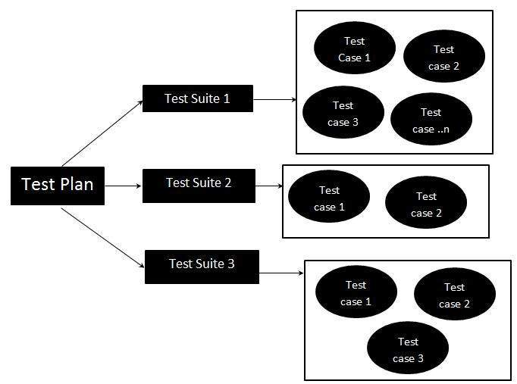
Test Suite - Diagram:

Slide 9
Selenium WebDriver - Advanced
Overview of cross Browser testing
Cross Browser testing is a type of non-functional testing that lets you check whether your website works as intended when accessed through:
1. Different Browser-OS combinations
2. Different devices
3. Assistive Tools

Slide 10
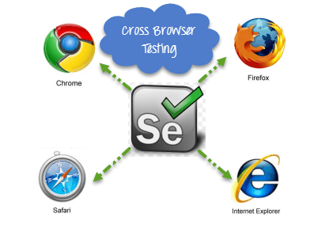
Different Browser-OS combinations i.e., on popular browsers like Firefox, Chrome, Edge, Safari—on any of the popular operating systems like Windows, macOS, iOS and Android.
Different devices i.e., users can view and interact with your website on popular devices—smartphones, tablets, desktops and laptops etc.
Assistive Tools i.e., the website is compatible with assistive technologies like screen readers for individuals who are differently abled.

Slide 11
Selenium Grid
Selenium Grid is a feature in Selenium that allows you to run test cases in different machines across different platforms. The control of triggering the test cases is on the local machine, and when the test cases are triggered, they are automatically executed by the remote machine.
•It supports distributed test execution. Initially, you have a local machine where you write the test cases and executes on the same machine. However, in a big organization, you have multiple test cases, and it's not possible to run all the test cases in the same machine. In a large organization, you have multiple servers, so local machine distributes the test cases across different machines/servers.

Slide 12
You can also run the test cases in parallel in multiple machines on Selenium Grid.
Hub
•A Hub is a central point or a local machine that receives all the test requests and distributes them to the right nodes. The machine which triggers the test case known as Hub
•There can be only one hub in a selenium grid.
•The machine which is containing the hub triggers the test case, but you will see the browser being automated on other machines.
Node
•Nodes are the selenium instances which will execute the test cases that you loaded on the hub. Nodes can be launched on multiple machines with different platforms and browsers.

Slide 13
PAGE OBJECT MODEL(POM)
•POM is a design pattern which is commonly used in Selenium for Automating the Test Cases.
This design pattern can be used with any kind of framework like keyword-driven, Data-driven, hybrid framework, etc. The Page object is an object-oriented class which acts as an interface for the page of your Application under test.
Page class contains web elements and methods to interact with web elements.
While Automating the test cases, we create the object of these Page Classes and interact with web elements by calling the methods of these classes.

Slide 14
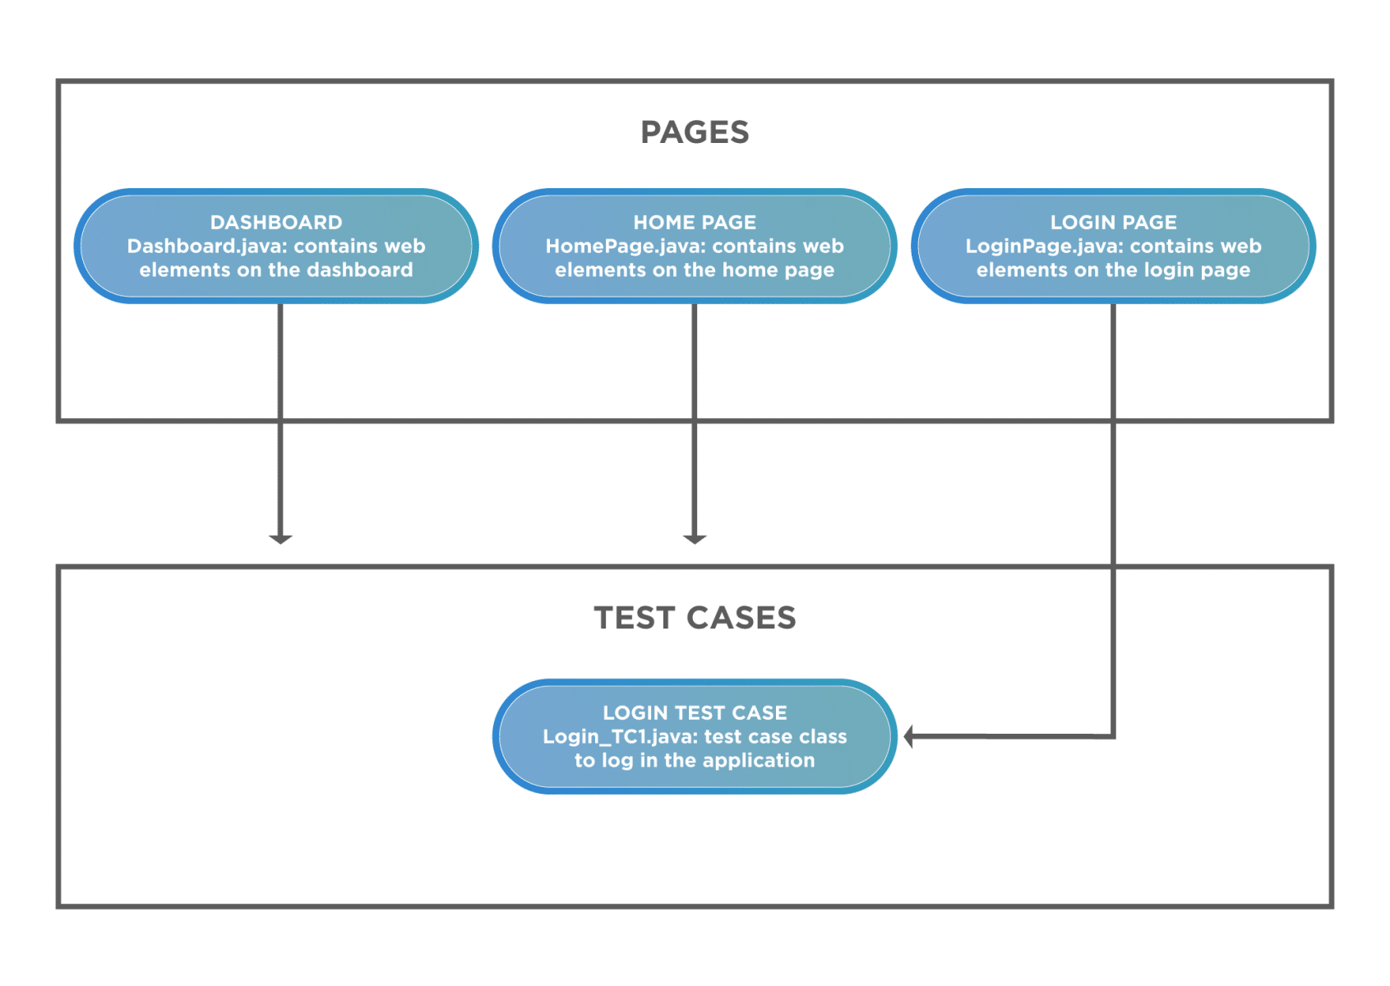
Page object model(Pom)

Slide 15
Thank you

